Slide 1
What is the NGDS
The National Geothermal Data System:
Implementation of the U.S. Geoscience Information Network
Stephen M Richard
Kim Patten
Virginia Geological Survey
August 7, 2013

Slide 2
Outline
How is it put together
Approach to Data Management
The Domain Steering Committee
Recommended data types
How does it work
Content Models
Interchange formats
Catalog

Slide 3
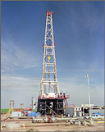
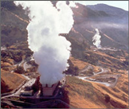
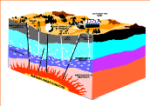
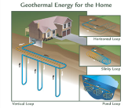
USGIN: Purpose
Make data resources of State and Federal geological surveys accessible online in a distributed network by
using common standards and protocols
working with data providers to implement these services.

Slide 4
Overview
NGDS is a data system, not a database
Discover and access geothermal data from many different sources
System is unified by:
Catalog and standardized metadata
Data access protocols and interchange formats (it’s the Web for data)

Slide 5

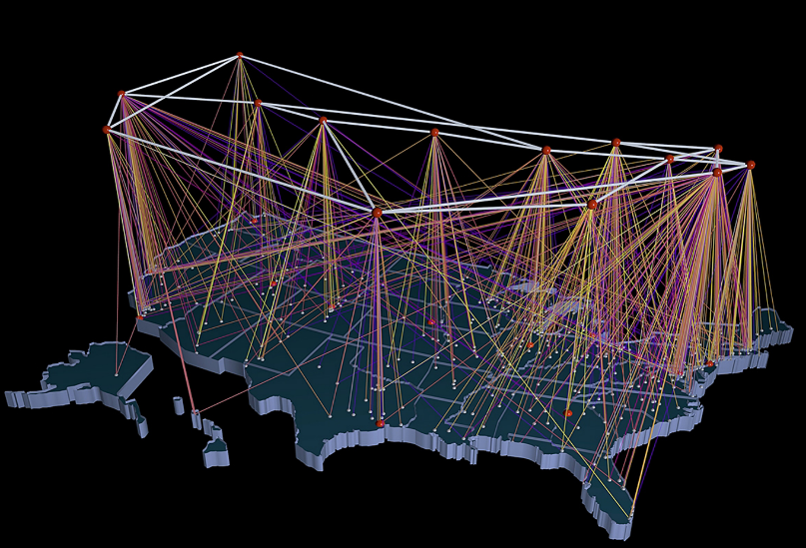




University of Utah Energy & Geosciences Institute
U.S. DOE Geothermal Data
Repository hosted at NREL
Oregon Institute of Technology,
Geo Heat Center
Stanford Reservoir Engineering
U of Nevada Reno
U.S. DOE Geothermal Data
Repository hosted at NREL
Southern Methodist University Heat Flow Laboratory
U.S.
Geological
Survey
50 State Geological Surveys
Managed by AZGS

Slide 6
What defines the network
Specifications
People and software using them
Information Exchanges
Service Protocol – how message are sent to ask for and get data
Content models – what information is available
Interchange formats – how the information is encoded (e.g. HTML, xml, json, txt, xls)

Slide 7
Why
Is interoperability worth the pain

Slide 8
Make things easier
Make life easier for the customer
They don’t have to do figure out new data structures
Create bigger market for applications
App works with different data providers
Facilitate machine processing
Make metadata easier
Don’t have to document data structure-it’s already done.
Simplify data maintenance

Slide 9
A distributed data system
Web services: the connections
Users
Data space
Data: the World Wide Web as the data store
Catalogs: listings of available resources

Slide 10
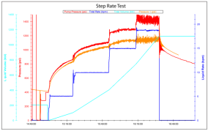
Data Types
Three sorts of information:
Data – information about the Earth and geothermal energy systems
Metadata – Information about resources (for discovery, evaluation, access)
Annotation – notes added to by the community (ratings, comments, reviews, usage…)

Slide 11
Outline
How is it put together
Approach to Data Management
The Domain Steering Committee
Recommended data types
How Does it work: information exchanges
Content Models
Interchange formats
Catalog

Slide 12
Domain Steering Committee
Formed to determine data priorities
Represent user community
Toni Boyd: Geo-Heat Center Oregon Institute Technology: direct use data - national
Roland Horne: Stanford University-Stanford Reservoir Engineering Conference papers and research results
Joseph Moore: Energy & Geoscience Institute-legacy resource and research data (Chair)
Lisa Shevenell: University Nevada, Reno – legacy to recent resource and research data

Slide 13
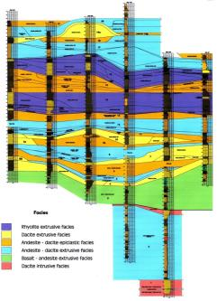
Domain Steering Committee
Solicit input from experts
Content models
User stories – functionality and data output
Sustainability – future user input
Prioritize data types needed by the geothermal community
Review content models and user stories with DOE invited experts
Provide recommendations to Project Management

Slide 14
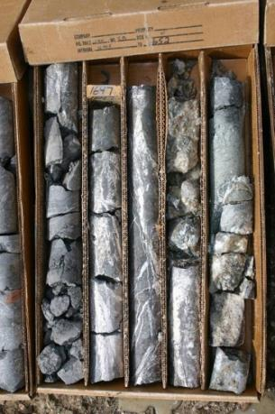
Data type recommendations
Well Logging
Geochemistry
Geophysics
Land Status and Ownership
Power Plant History
Well field Development Costs
Geothermal system resource models

Slide 15
Outline
How is it put together
Approach to Data Management
The Domain Steering Committee
Recommended data types
How does it work
Content Models
Interchange formats
Catalog

Slide 16
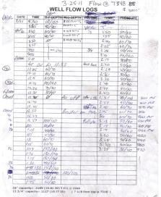
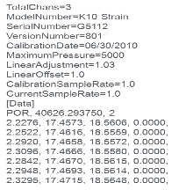
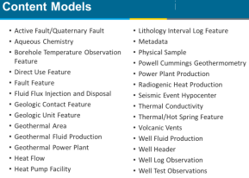
Data Interoperability Tiers
Tier 1: unstructured content in files
Text, images, graphics files
MS Word, Adobe Acrobat, Illustrator, TIFF….
Tier 2: Structured data, custom formats
May be accessed in files or via services
Excel, Microsoft Access, dbf, xml…
Tier 3: Information Exchange:
Structured data in standard schema and encoding
Deliver via web service, or in file.
Tier 1
Tier 2

Slide 17
Being part of the system
Any Tier: Resource is described by metadata in the system catalog
Tier 1– File accessible on the Web
Tier 2– Structured, user does data integration
need to document data format
Tier 3 – Structured, provider does data integration
mapped to community interchange scheme
provider has to validate format

Slide 18
The Catalog
Services: structured data discovery and access
Data space
Data: the World Wide Web as a file system
Catalog: registry of available resources

Slide 19
Metadata Content Model
Access constraints
Language
Quality
Lineage
Citation
Distribution contact
Metadata
Date
Contact
Specification
Identifier
Title
Extent
Geographic
Vertical
Temporal
Access instructions
Description
Keywords
Originator(s)
Date
Resource ID
Online document: http://lab.usgin.org/profiles/doc/metadata-content-recommendations

Slide 20
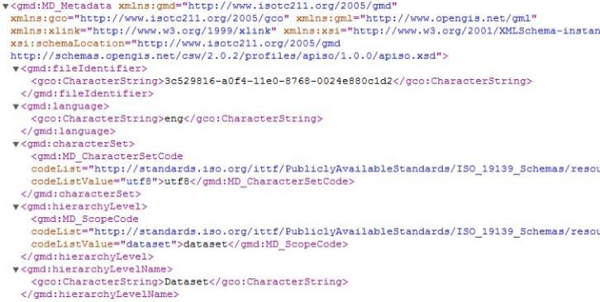
Metadata Interchange
Standard interchange format: USGIN Profile for ISO 19139 metadata (XML)
…

Slide 21
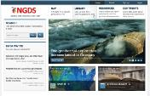




Metadata cloud
NGDS portal – access point for geothermal community
NGDS aggregator: collect metadata for all NGDS resources
NGDS portal
Metadata contributors
Other portals

Slide 22
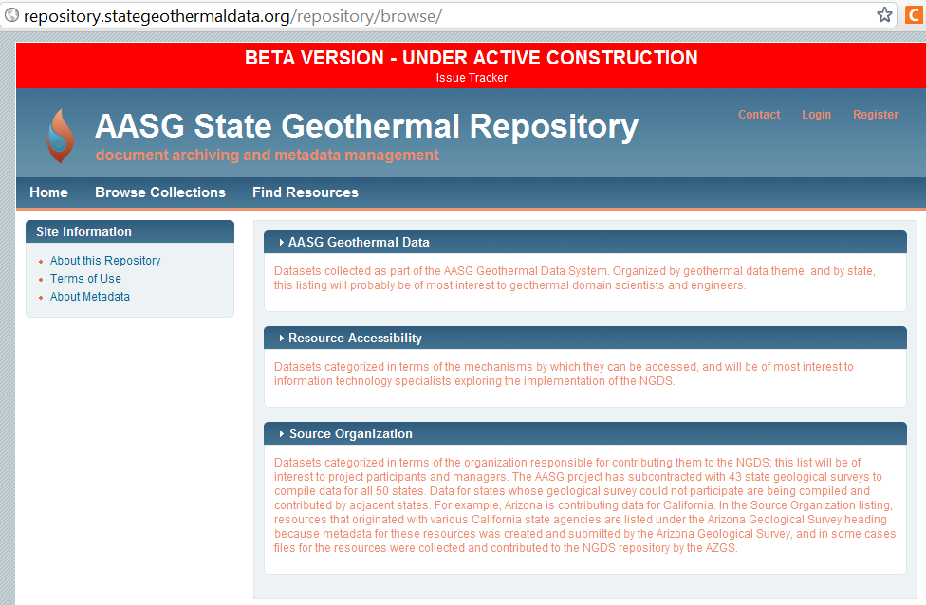
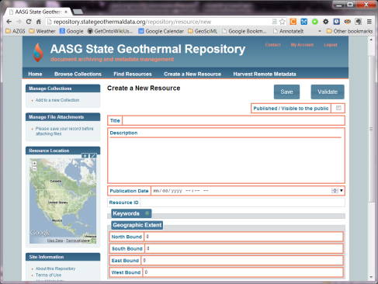
Metadata Repository Tool
Generate and manage metadata
Registry of resources
Upload capability
Django/NodeJS implementation

Slide 23
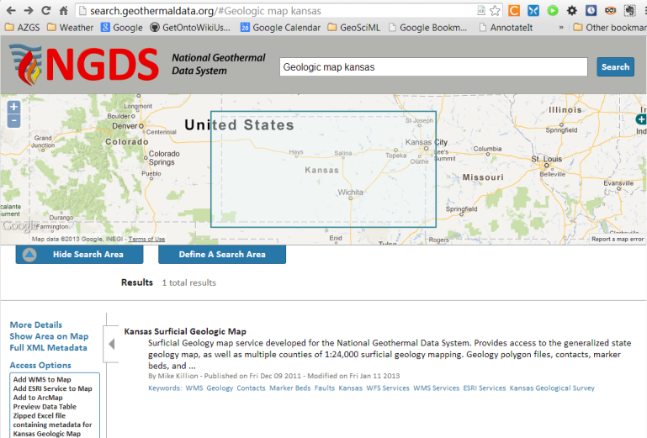

Search Client
Uses CSW interface

Slide 24
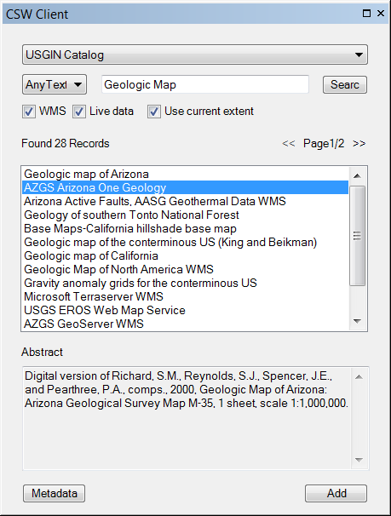
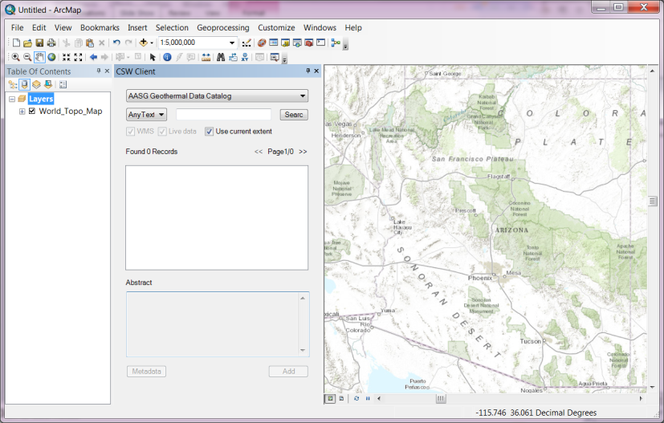
ArcGIS CSW Client

Slide 25
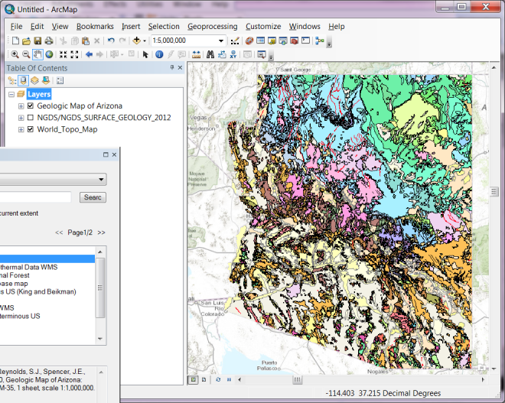
Display map in ArcMap

Slide 26
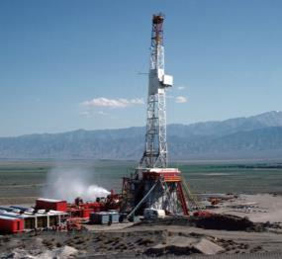
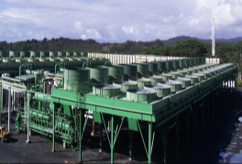
Tier 3: Information Exchanges
<whm:facilityType>Well</whm:facilityType>
Conventions for how information will be sent between computers
Designed for consumption by computer software
Content Model:
Defines the information content
Data schema
May be implemented with various encoding formats
Encoding formats
HTML, XML, JSON, NetCDF, TIFF, JPG…
facilityType: “Air-cooled binary plant”

Slide 27
Content Models (Tier 3)
Active Fault/Quaternary Fault
Aqueous Chemistry
Borehole Temperature Observation Feature
Direct Use Feature
Fault Feature
Fluid Flux Injection and Disposal
Geologic Contact Feature
Geologic Unit Feature
Geothermal Area
Geothermal Fluid Production
Geothermal Power Plant
Heat Flow
Heat Pump Facility
Lithology Interval Log Feature
Metadata
Physical Sample
Powell Cummings Geothermometry
Power Plant Production
Radiogenic Heat Production
Seismic Event Hypocenter
Thermal Conductivity
Thermal/Hot Spring Feature
Volcanic Vents
Well Fluid Production
Well Header
Well Log Observation
Well Test Observations
Notes:
27

Slide 28
Data Getter Demo

Slide 29
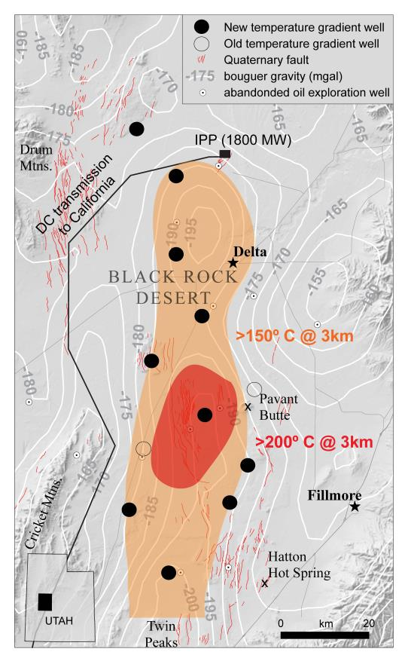
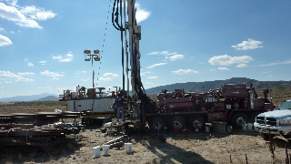
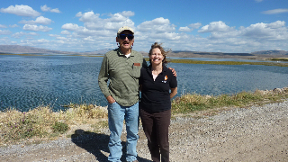
New Data Collection
New temperature gradient wells completed in UT, ID, WA, & WI; pending wells in OR & NV
Sedimentary basin geothermal
Black Rock Desert of central UT; temperatures of 150 to 250 degrees C at 3-4km depth
Program Officer Arlene Anderson and
ID Geological Survey PI, John Welhan
pose at one of three drill sites within the
Blackfoot-Gem Valley of SE ID

Slide 30
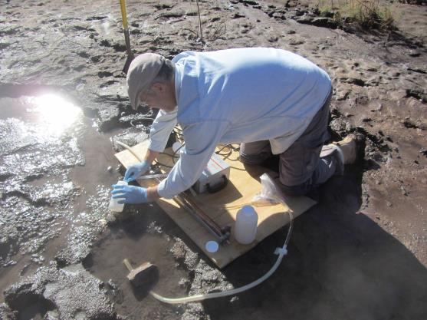
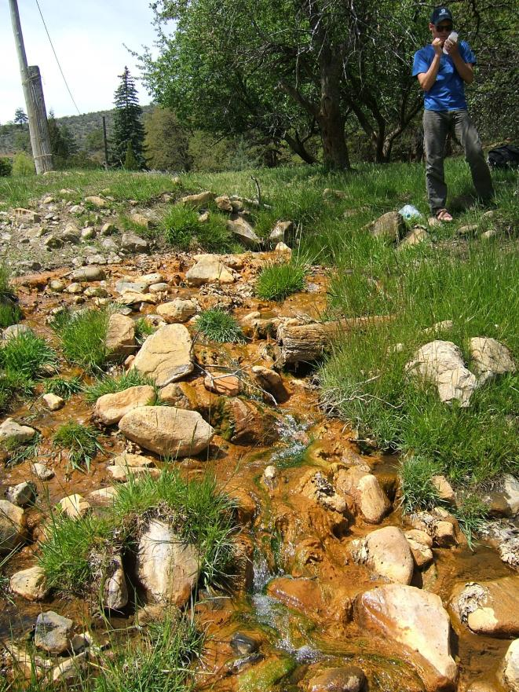
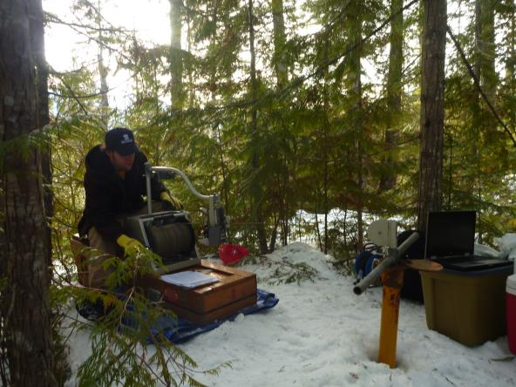
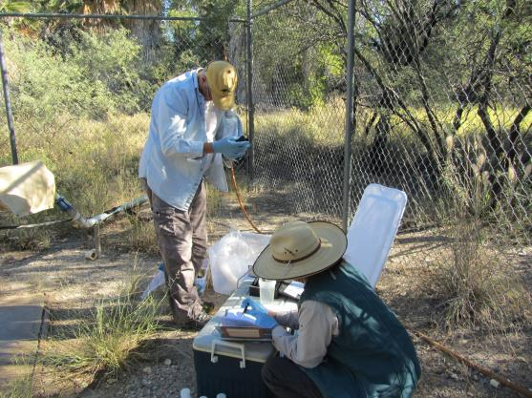
New Data Collection
Thermal Spring Sampling in WA & AZ: results being entered into the NGDS
Temperature logging in WA

Slide 31
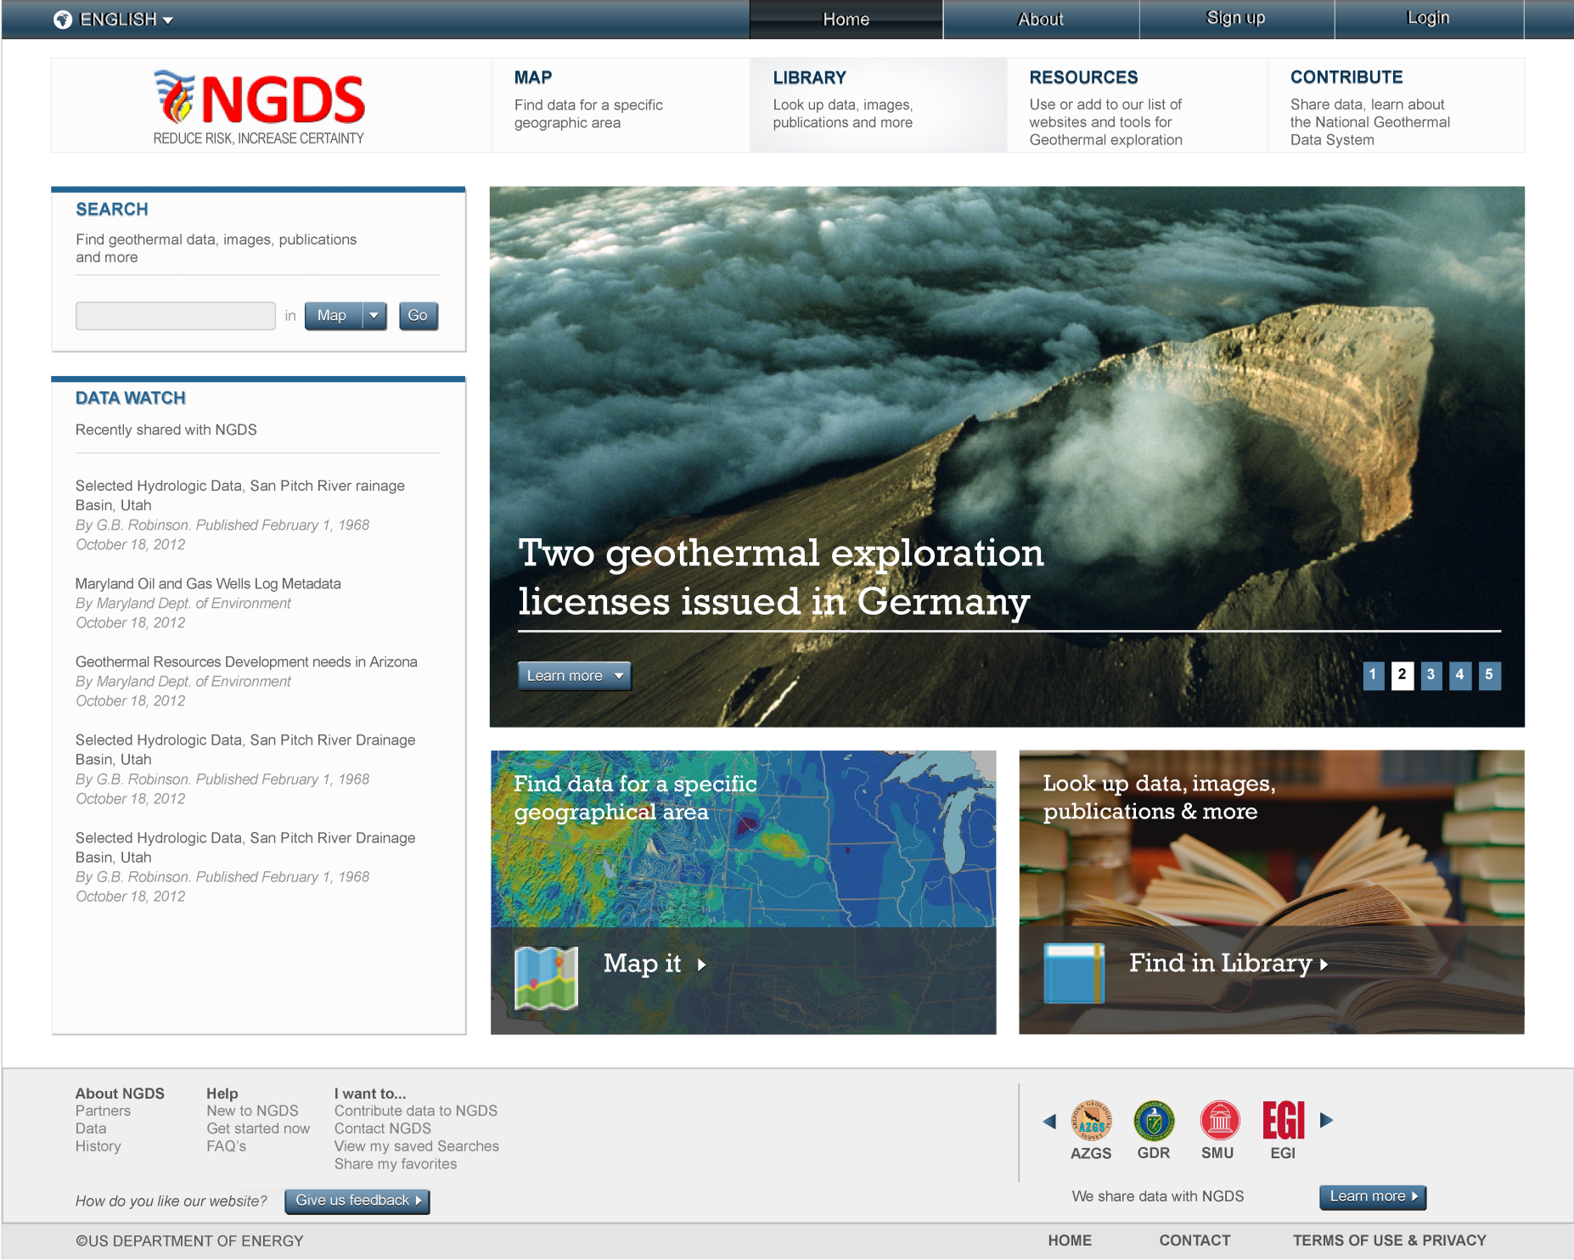
Notes:
** Labeled as Final Design in NGDS UI Design 7/22/2013 presentation.

Slide 32
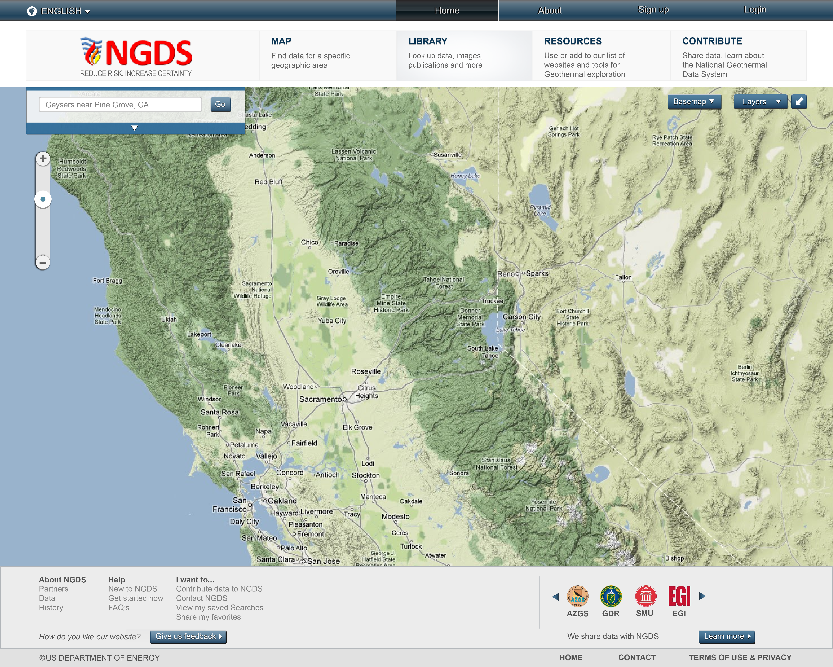
Notes:
Search results window (top left) collapsed view

Slide 33
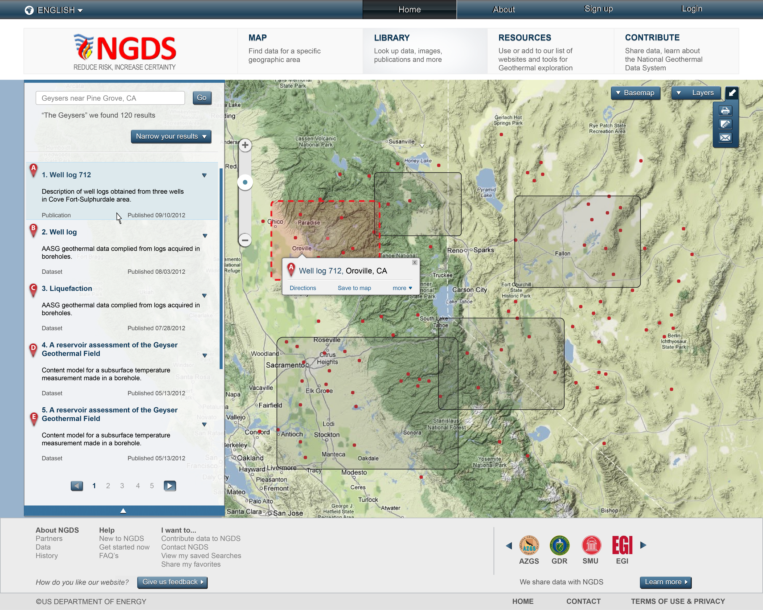
Notes:
Search results window viewable

Slide 34
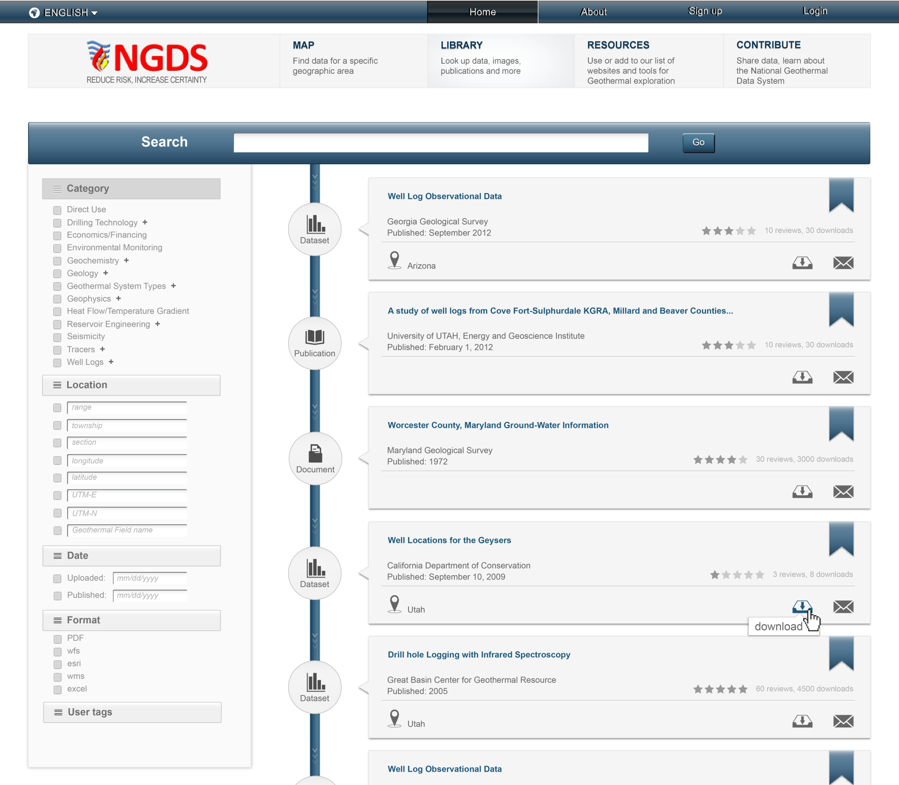
Notes:
Library view

Slide 35
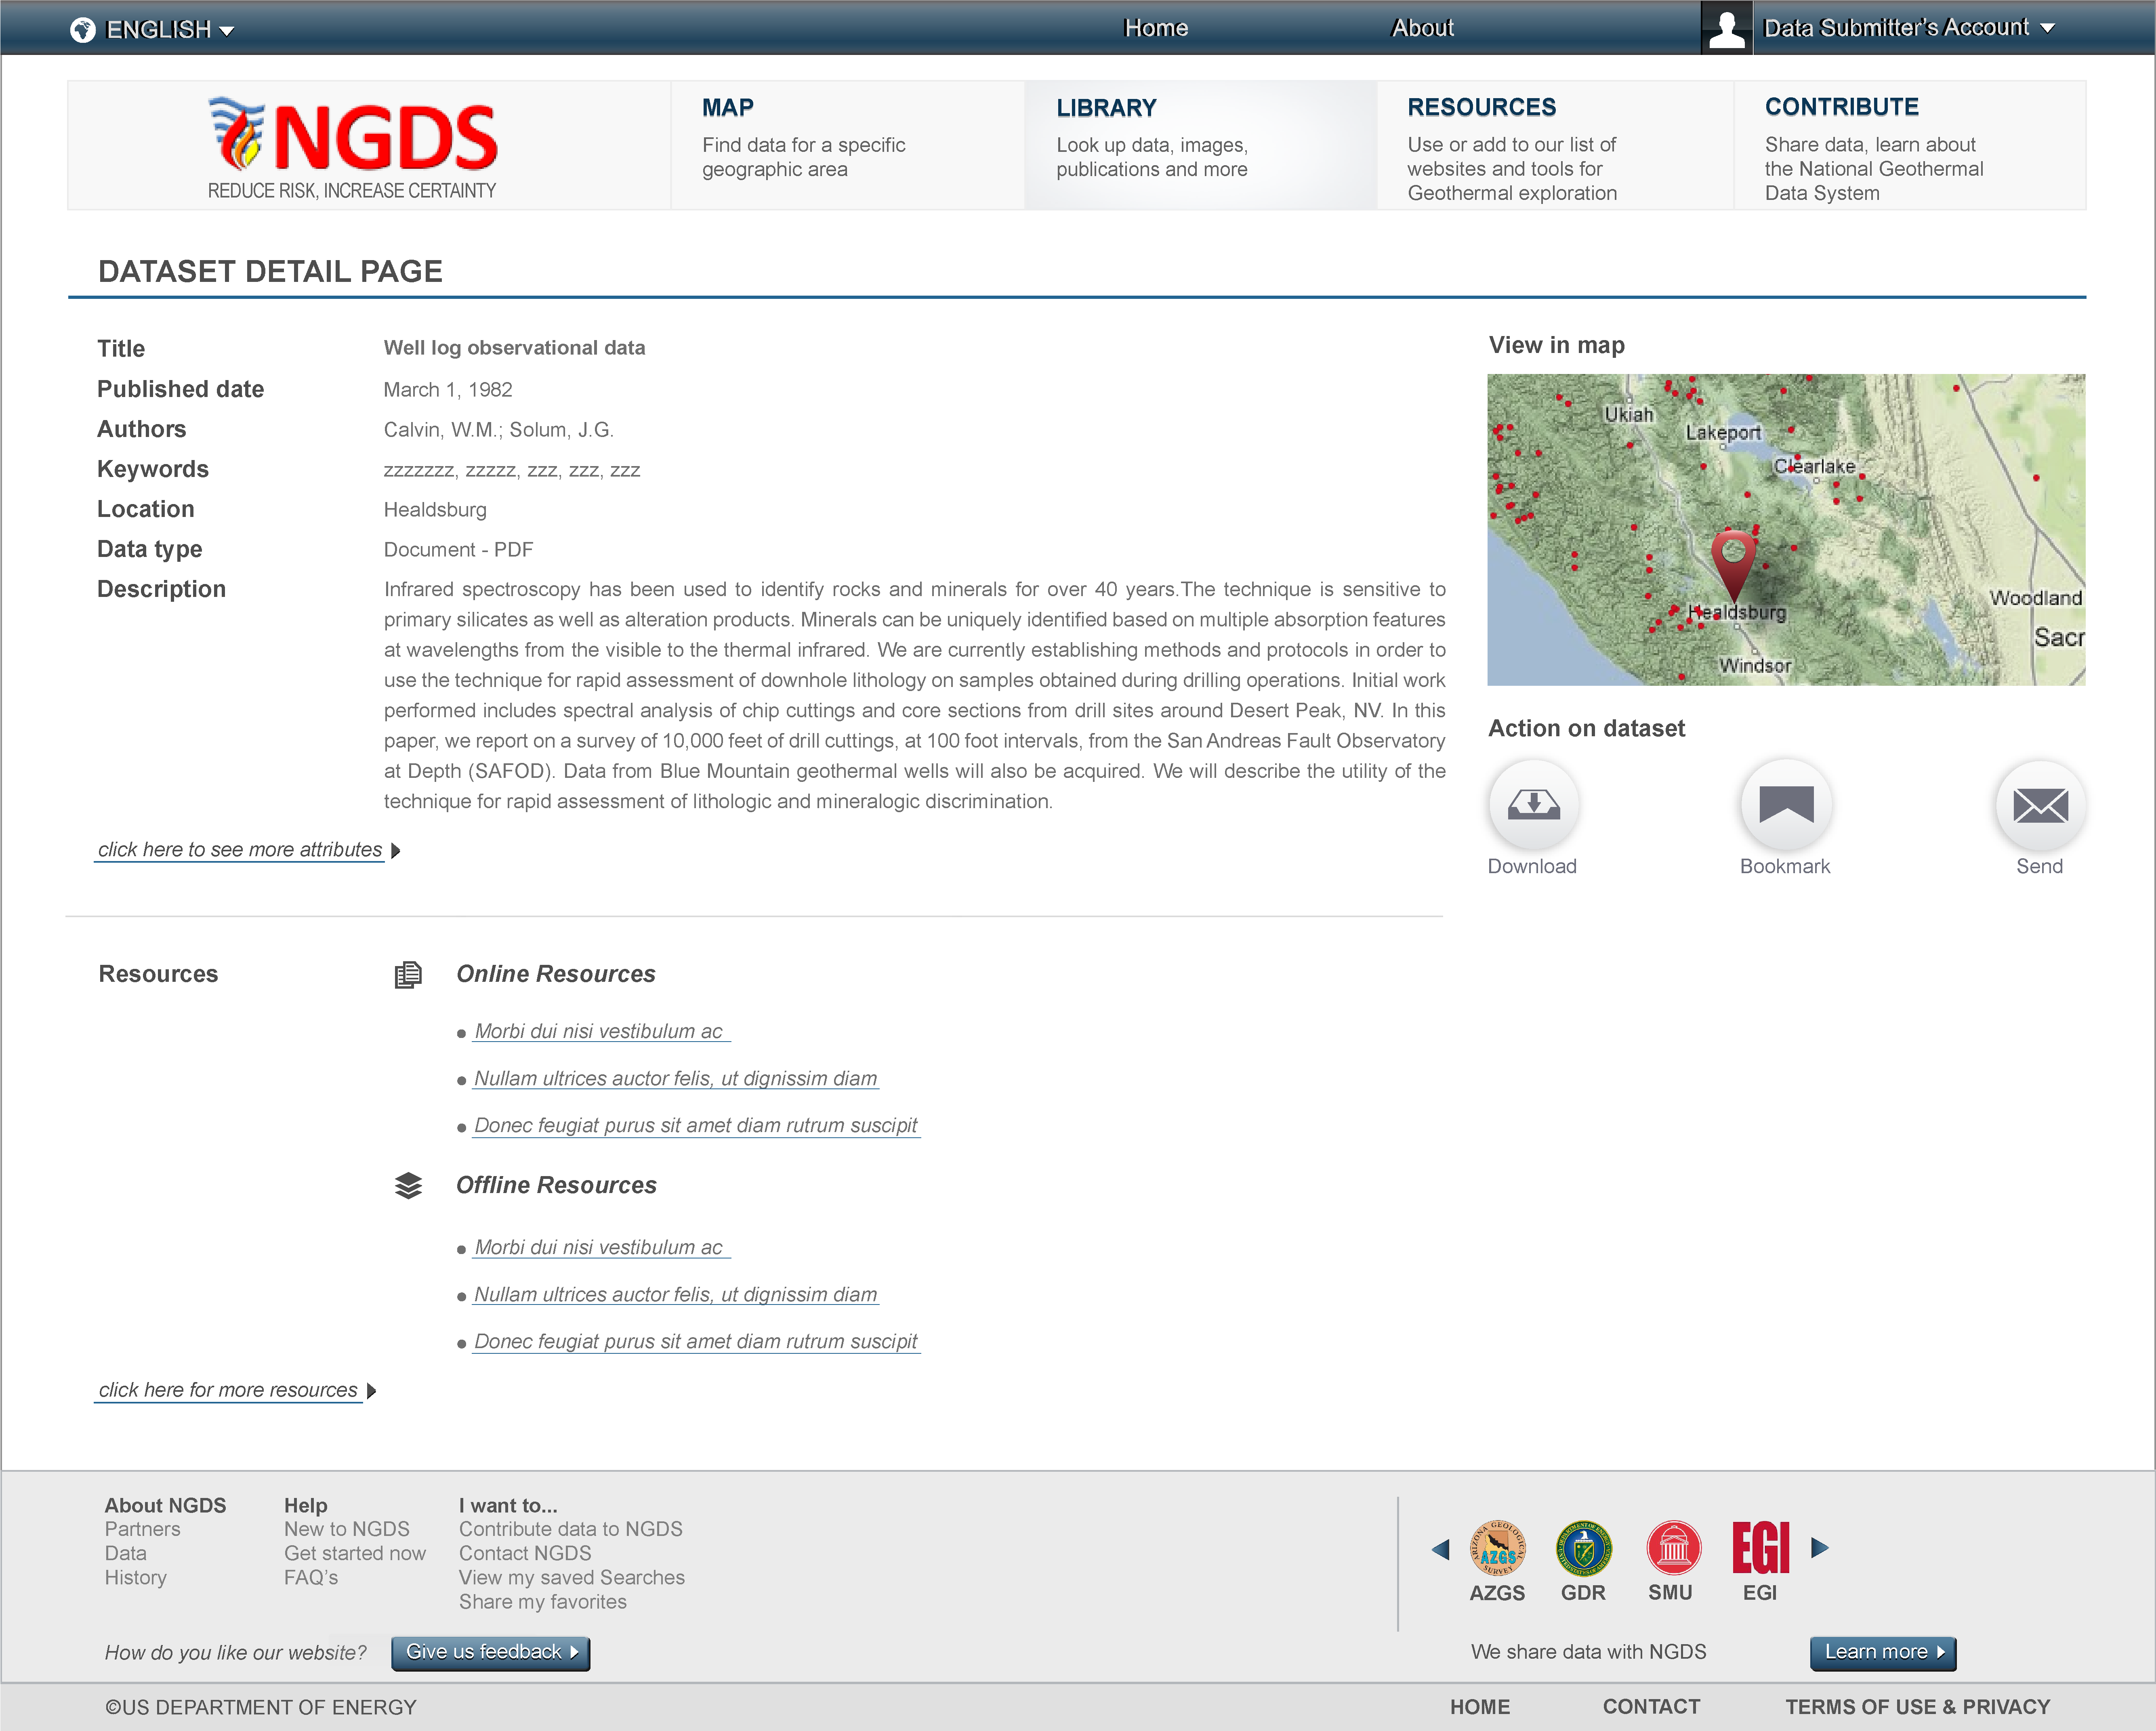
Notes:
Library View

Slide 36
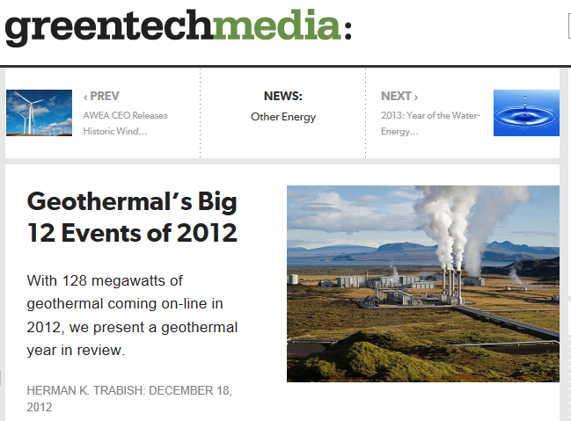
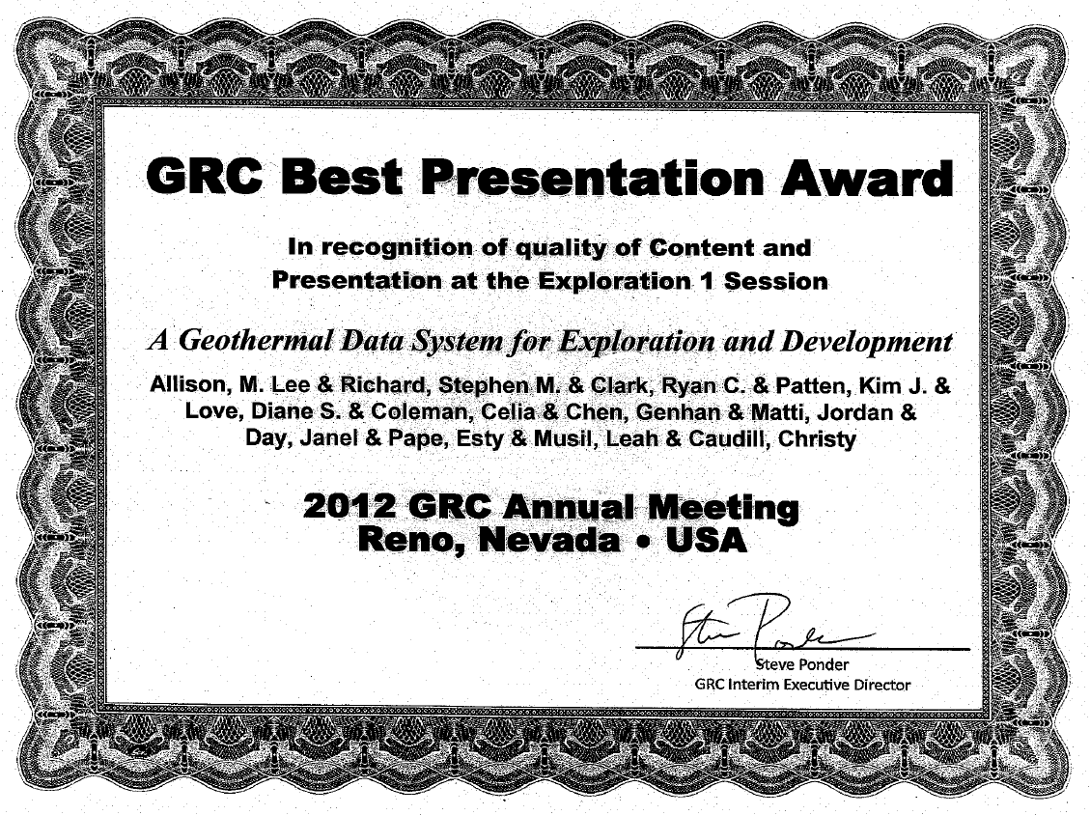
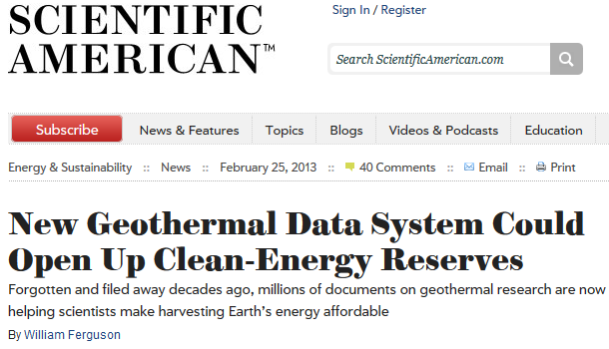
Industry Recognition
UGS discovery in the Black Rock Desert listed as #7
One of 34 Best Presentation Awards from over 180 presentations at 2012 GRC

Slide 37
Delivery Platform
File download
simple Web link that results in a file download
no support for understanding content
little or no automation is possible
Web application
User-driven computer program, run in client browser
form-based querying, browser-based visualization
may offer file downloading (clip and ship, query results…)
Web Service
computer program executes requests sent via the World Wide Web
Interface for machine to machine interaction
Execute filtering or processing of data on server side
Notes:
Add NIAB information

Slide 38
Tiers and delivery platforms
 | Tier 1 | Tier 2 | Tier 3
File download | X | X | X
Web application |  | X | X
Web service |  | X | X

Slide 39
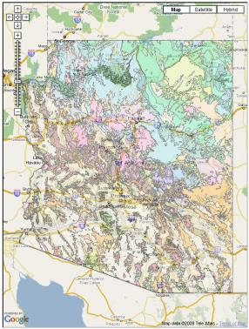
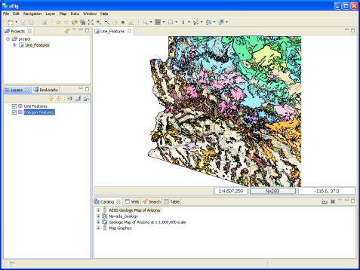
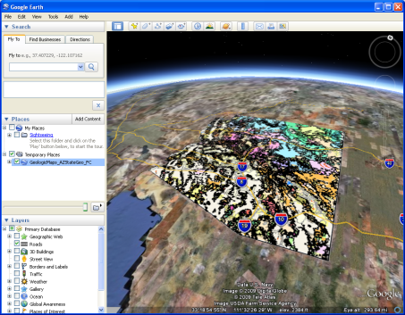
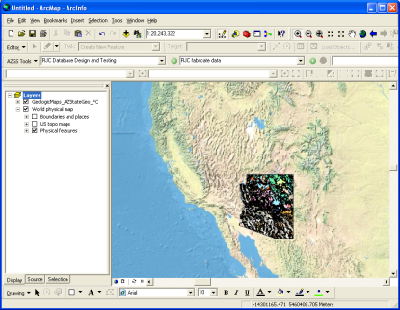
Data Delivery Platform: web services
OGC Services
-- Useful in Existing Applications
WMS for providing a symbolized portrayal of vector data
WFS for full access to attributes and to download vector data
WCS for access to continuous raster data

Slide 40
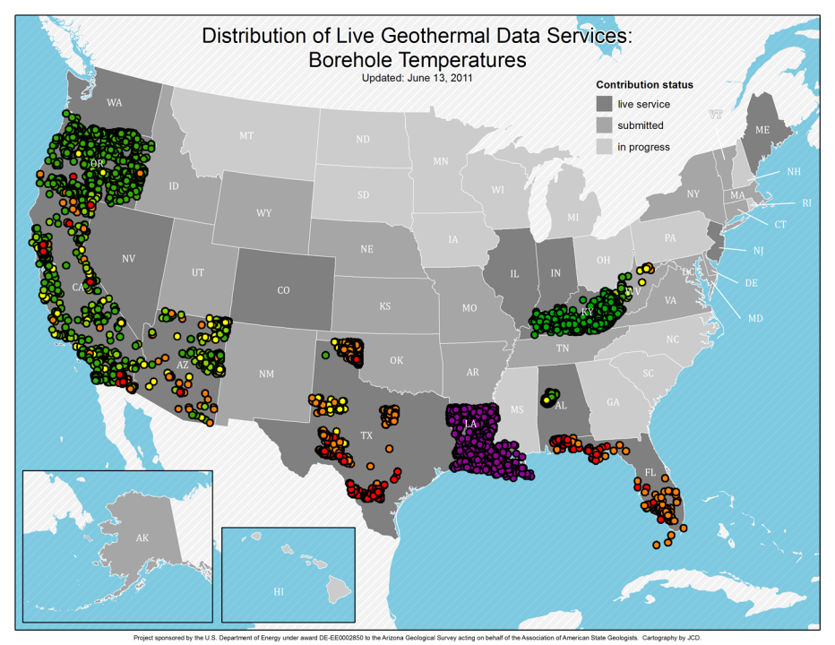
Consistent map legends
OOOPS!

Slide 41
Protocol – Web Feature Service (WFS)
Open Geospatial Consortium Web Feature Service
Standard, structured encoding of content
Each feature defines content model (xml schema)
Feature service –
designed for data access based on features (representation of geolocated entity with attributes)

Slide 42
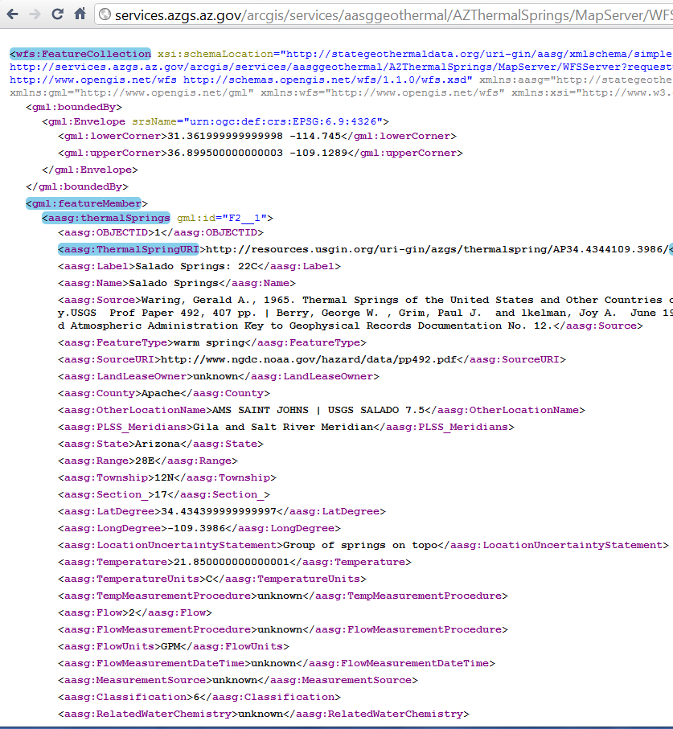
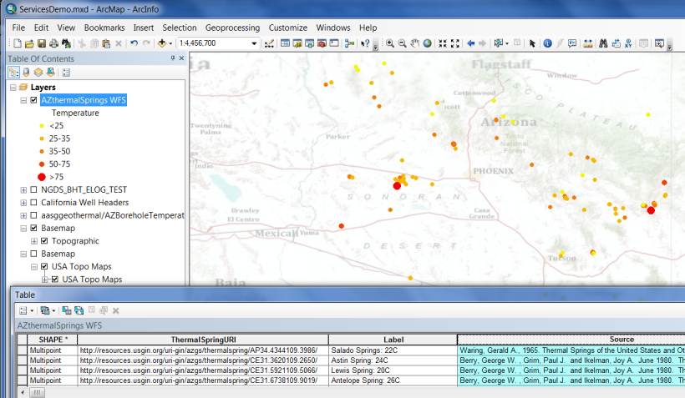
WFS example-Interchange format

Slide 43
USGIN URI redirect
URIs dereference to one or more online representation of each resource. Examples:
http://resources.usgin.org/uri-gin/isgs/well/API:120010005200/
http://resources.usgin.org/uri-gin/isgs/welllog_tif/120010010800_ies/
Create URI:
Concatenate:
the redirect host path: ‘http://resources.usgin.org/uri-gin/’
naming authority for the data provider (i.e., azgs, cadoggr, nhgs)
token, specific to the dataset (i.e., bhtemp, welllog, drillstemtest)
unique identifier for each record
Notes:
Simplify

Slide 44
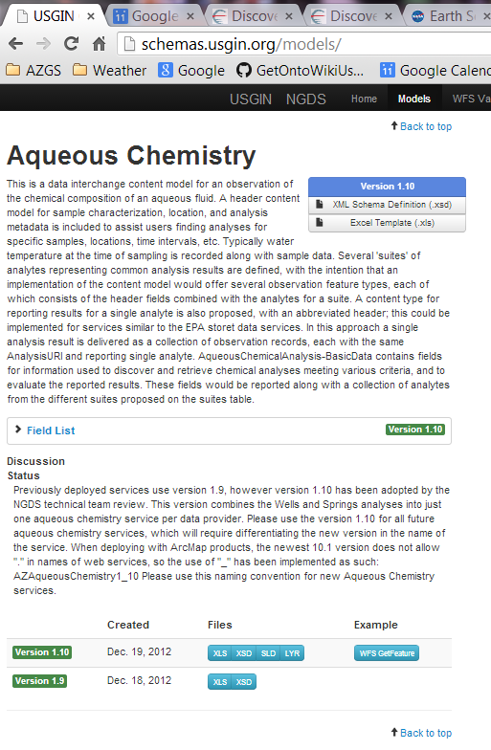
Tools Schema Repository
Registry/repository
Field descriptions from schema annotation
Links to Excel workbook view
Links to XSD
Versions
Link to example instances

Slide 45
Conclusions
The World Wide Web is the file system and data repository
Resources include:
Structured and unstructured data in files (most of the content)
Standardized structured data accessible through web services (metadata and some data)
Information exchange specifications:
Conventions for content model and encoding enable applications to work with multiple data sources

Slide 46
Discussion
USGIN:
Community for developing Geoscience Information Exchanges
Metadata exchange is most important
Majority of content is unstructured documents
Challenge: what is value proposition for ‘long tail’ information exchanges

Slide 47
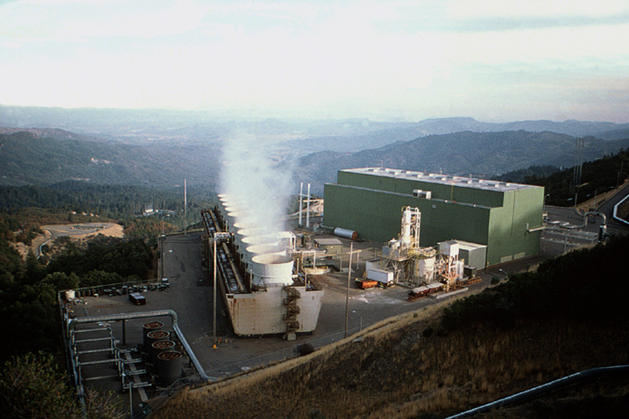
Thank You
The Geysers

Slide 48
Intentionally blank
Begin extra slides

Slide 49
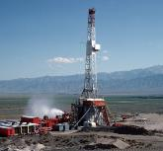
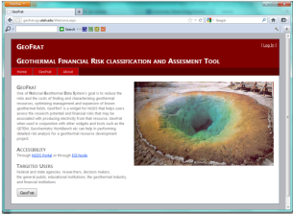
Approach to Data Management
Use WWW infrastructure, Open Geospatial Consortium (OGC) services, ISO standards
Simple interchange formats
Tiers of interoperability

Slide 50
NGDS_Resource
+
itemURI :anyURI
+subject
+
itemType :term
+
source :longText
1
+
relatedItem :link [0..*]
+documentation
+annotation
0..*
NGDS_DataResource
Metadata
Annotation
+
itemName :text
+
itemDescription :text [0..1]
1..*

Slide 51
NGDS_DataResource
+
itemName :text
+
itemDescription :text [0..1]
Tier 2,3
Tier 1
NGDSdataItem
+member
Dataset
UnstructuredResource
+
otherID :text [0..*]
1..*
Location
+position
Feature
Observation
1
+
featureOfInterestName :text
+
shape :geometry
1
+
label :shortText
+
featureOfInterestURI :anyURI
+
symbol :text
FeatureOfInterest
+
procedure :longText
+
observationDate :dateTime
GeologicFeature
Facility
SamplingFeature

Slide 52
Catalog system issues
How to manage metadata
Various streams for importing
Management system based on conceptual model
Metadata for machines– connect user to services inside of their user environment
Requires machine-actionable links
Document and file searching should be done with standard search engines

Slide 53
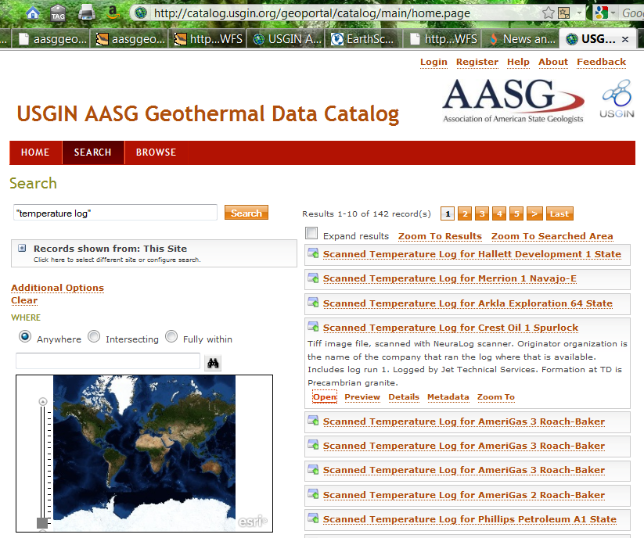


Slide 54
Domain Steering Committee Members
Toni Boyd: Geo-Heat Center Oregon Institute Technology: direct use data - national
Roland Horne: Stanford University-Stanford Reservoir Engineering Conference papers and research results
Joseph Moore: Energy & Geoscience Institute-legacy resource and research data (Chair)
Lisa Shevenell: University Nevada, Reno – legacy to recent resource and research data

Slide 55
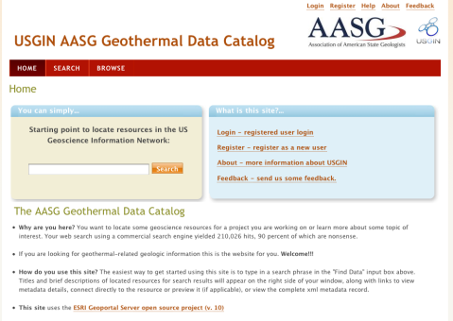
Search interfaces
Catalog -- for data discovery
Collection of consistent metadata describing network resources
Tested various catalog service implementations;
Current interface is ESRI Geoportal
(http://catalog.geothermaldata.org/geoportal)

Slide 56
AASG Geothermal data
Catalog file-based resources in repositories
Simple feature (flat file) schema
27 content models
More on the way –
http://geothermaldata.org
The goal is simple, really….

Slide 57

turn this….
Winona State U.

Slide 58
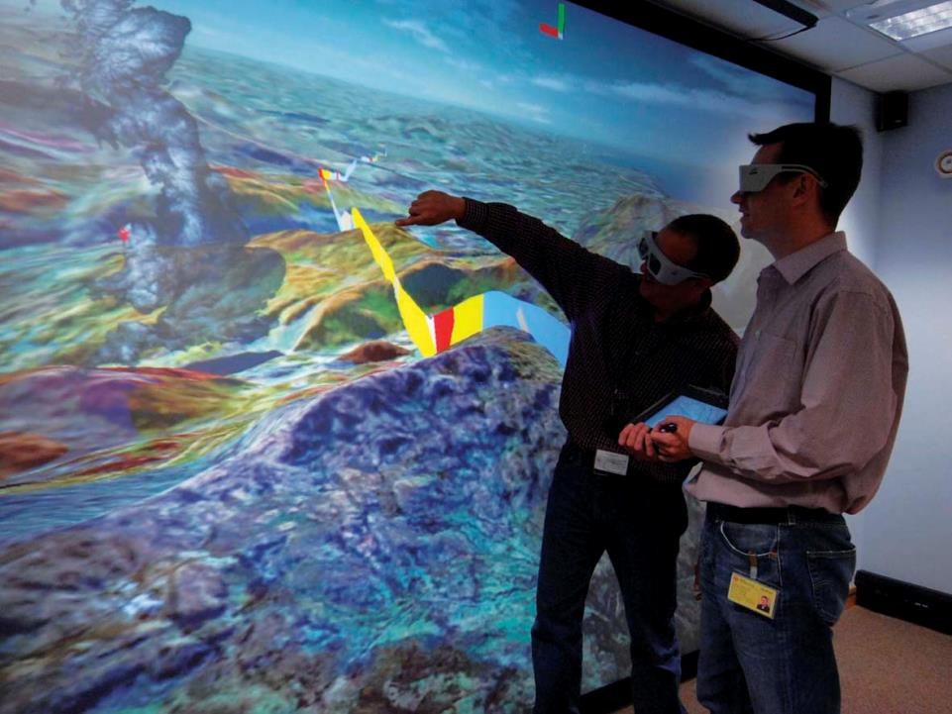
….into this
NERC 2008
Notes:
58
58

Slide 59

Example: NGDS Borehole temperatures

Slide 60
Linked Data
Use identifiers that can be dereferenced on the WWW
Enable navigation between related resources
Leverage web architecture
GitHub\USGIN\Workshops\WesternRegionalWorkshopWMS_URIDemo.mxd

